Slide 1



SUMMER
TRAINING
Instructor : Doaa M.Taha
Data Analyst

Slide 2
Session 4 : Functions

Slide 3
Learning Outcomes
By the end of this session, you will be able to:
Define a function.
Create and call functions.
Pass parameters to functions.
Return values using return.
Use default and keyword arguments.
Solve problems using functions.

Slide 4
Why Do We Need Functions?
Imagine you need to calculate the area of 100 rectangles.
Without functions, you will repeat the same code many times.
Functions help us:
Reuse code
Reduce repetition
Improve readability
Make debugging easier

Slide 5
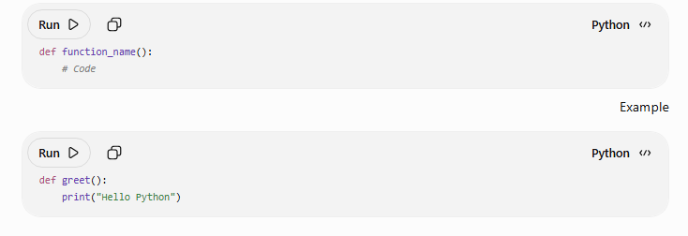
Function Syntax

Slide 6
Calling a Function
def greet)):
print("Hello")
greet()
Exercise
Create a function called welcome() that prints:
Welcome to NTI

Slide 7
Functions with Parameters
Parameters allow us to send data to a function
def greet(name):
print("Hello", name)
greet("Ahmed")
greet("Sara")

Slide 8
Multiple Parameters
Exercise
Create a function that prints the rectangle area .
def add(x, y):
print(x + y)
add(5,3)
add(10,7)
rectangle(length, width)

Slide 9
Practice Time
Write functions to:
Print student name.
Print country name.
Calculate circle area.
Calculate average of 3 numbers.

Slide 10
The return Statement
sends a value back to the caller.
def add(a,b):
return a+b
result = add(5,7)
print(result)

Slide 11
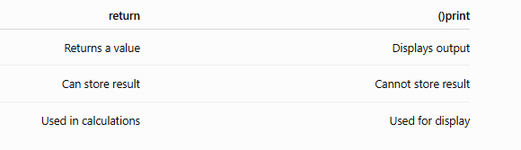
print() vs return
Write a function that returns the square of a number
square(5)

Slide 12
Returning Multiple Values
A function can return more than one value.
def calculate(a, b):
return a+b, a-b
x, y = calculate(10, 5)
print(x)
print(y)

Slide 13
Practice
Write a function that returns:
Sum
Average
of two numbers.
Example
result = calc)10,20)

Slide 14
Default Arguments
A default argument is used when no value is provided.
def greet(name="Guest"):
print("Welcome", name)
greet()
greet("Ahmed")

Slide 15
Practice
Write a function
power(base, exponent=2)
Exemple
Power(5)
Power(5,3)

Slide 16
Thank You

